Slide 1
The event will begin momentarily.
This event is being recorded
Captions are available by clicking the CC icon in the Zoom toolbar below
ASL is provided
For more information and to download presentation materials visit: www.access-board.gov/av

Slide 2




Inclusive Design of Autonomous Vehicles: A Public Dialogue
Accessibility for Passengers with Mobility Disabilities: Part 2 Maneuvering and Securement

Slide 3
Agenda
Presentations
U. S. Access Board – Scott Windley
Robotics Research – Bryan Brillhart
Q & A
University of Michigan – Dr. Kathleen D. Klinich and Miriam A. Manary
Q & A
University at Buffalo – Dr. Jordana Maisel
Q & A
Open Dialogue
Dialogue continues online
https://transportationinnovation.ideascale.com/
PowerPoint slides available for download at:
www.access-board.gov/av

Slide 4
How to Participate
Ask Questions to Presenters
Submit questions using Zoom’s Q & A feature throughout the event
Ex. “Question - What are wheelchairs?“
Ex. “Question for Presenter 1 – Did your study look at scooters?”
Moderator will read question
May not get to all questions
Alternative: Email events@access-board.gov
Contribute to Open Discussion
Request to speak using Zoom’s Q & A feature
Ex. “Microphone - I’m Beth from XYZ Company and would like to talk about automated doors”
Ex. “Microphone - I’m Alex and I’d like to share my experience using an AV”
Host will enable your microphone
Moderator will call on you to unmute and speak
ASL – if you wish to be visible for signing, indicate in request
Online dialogue
http://transportationinnovation.ideascale.com/
For assistance, email: ePolicyWorks@dol.gov

Slide 5
Existing Accessibility Guidelines
ADA Accessibility Guidelines for Transportation Vehicles (1991, 1998)
www.access-board.gov/ada/vehicles
Updated Guidelines for Buses and Vans (2016) (not yet adopted by DOT)
www.access-board.gov/guidelines-standards/vehicles/update-buses-vans/guidelines-text
For technical assistance on these guidelines:
800-872-2253 (v)
800-993-2822 (tty)
ta@access-board.gov

Slide 6
U. S. Access Board: Accessibility Guidelines for Buses and Vans
Scott Windley, Accessibility Specialist

Slide 7
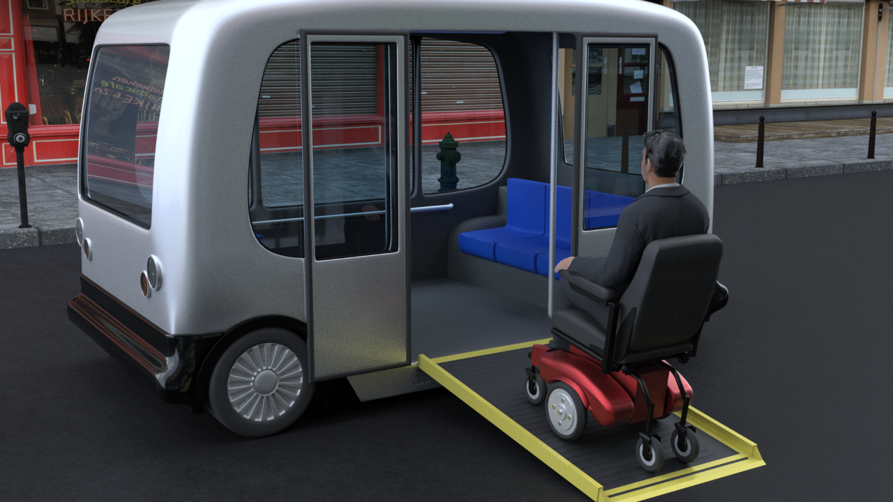
Boarding and Exiting

Slide 8
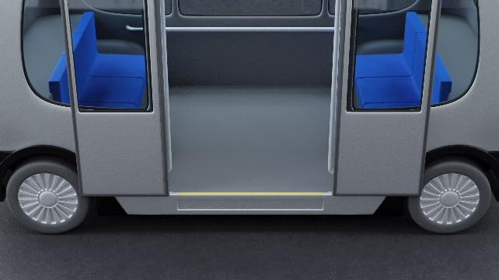
Technical Criteria
Walking Surfaces
Passenger Access Route
Maneuvering Through Vehicle
Securement Location Size
Means of Securement
Maneuvering and Securement
Maneuvering so that wheelchair users can get from door to securement space.
Means of securement.

Slide 9
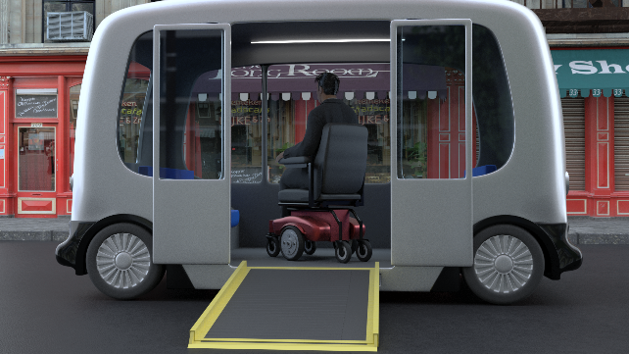
Maneuvering
Passenger Access Route
Sufficient clearances to permit passenger using a wheelchair to:
Get from doors to wheelchair space
Position for securement.
Back to doors for exit.

Slide 10
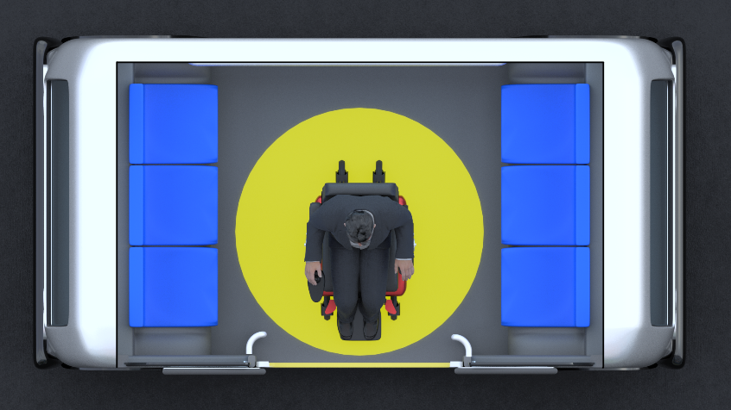
Recommendation
Turning Space
If there is room a turning space would provide greater maneuvering ability.

Slide 11
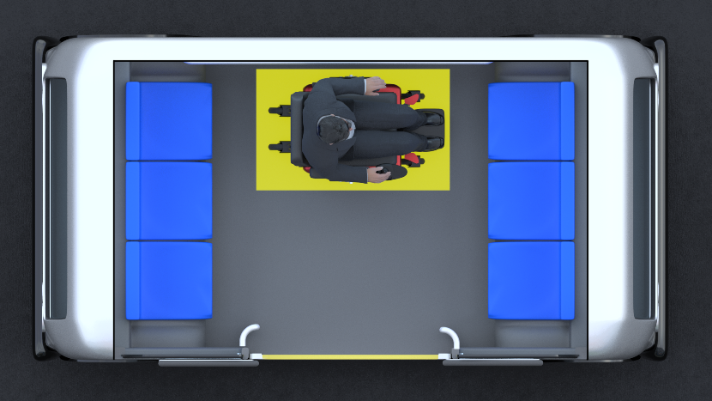
Wheelchair Location and Securement
One unobstructed side of each wheelchair space shall adjoin or overlap a passenger access route.
Wheelchair spaces shall be 30 inches min. width and 48 inches min. length.
Securement System (front facing).

Slide 12
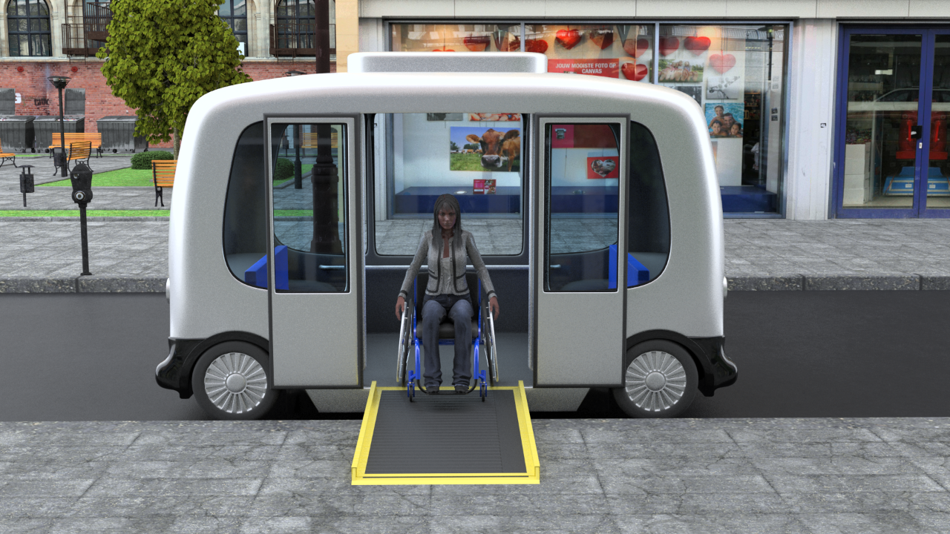
Maneuvering & Securement

Slide 13

Bryan Brillhart
Robotics Research

Slide 14
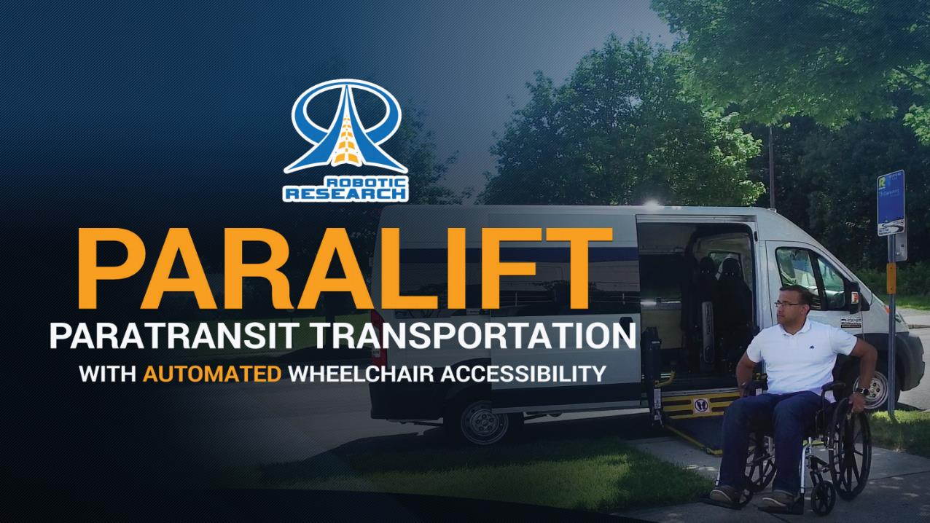
Paralift
®
Robotic Research Proprietary
14

Slide 15

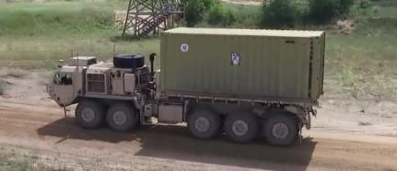
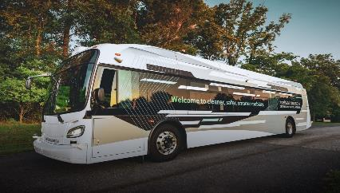
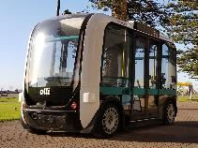
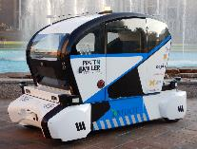
Robotics company with over 20 Years of experience in Unmanned Systems
Robotic Research has integrated autonomy on well over 20 different commercial and military vehicles for air, ground, and sea applications.
Since its founding in 2002, Robotic Research has been involved in most of the Army’s major autonomous vehicle programs and currently is the Autonomy Kit Prime Contractor for the largest Army autonomous vehicle projects, AGR and ExLF.
Robotic Research is leveraging its military technology for autonomous commercial transportation by teaming up with Local Motors, a leading innovator in Smart Mobility, and with New Flyer, the largest bus manufacturer in North America, and with Pratt & Miller, also known as Corvette Racing.

Slide 16
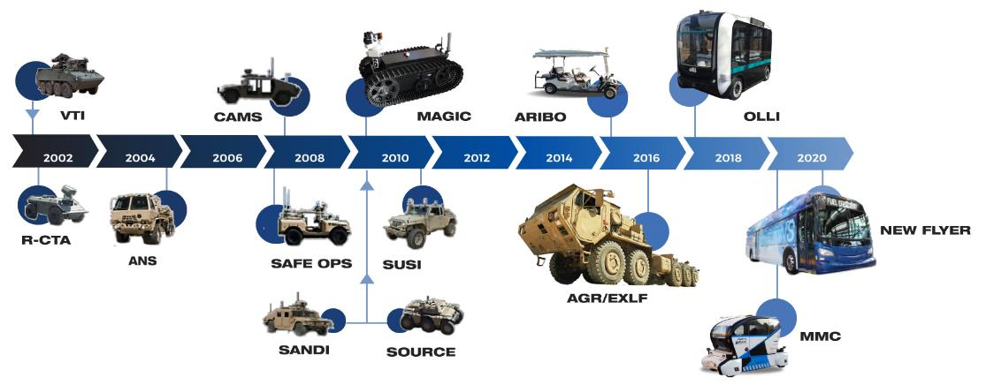
Robotic Research History

Slide 17
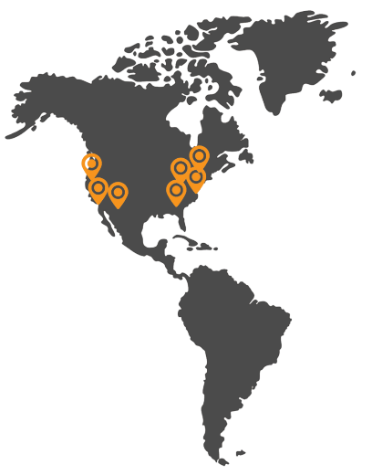
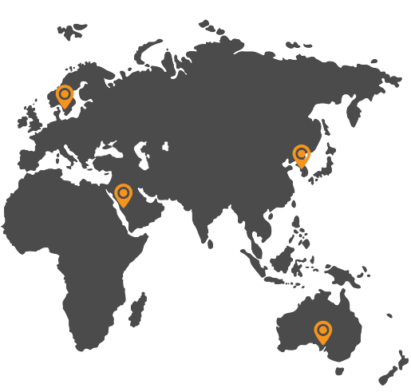

Shuttles Operating on 4 Continents
Adelaide, Australia
Copenhagen, Denmark
Mechelen, Belgium
Seoul, South Korea
Thuwal, Saudi Arabia
Tokyo, Japan
Turin, Italy
Akron, OH
Baltimore, MD
Buffalo, NY
Chandler, AZ
Chicago, IL
Clarksburg, MD
Concord, CA
Fort Myer, VA
Greenville, SC
National Harbor, MD
Peachtree Corners, GA
Phoenix, AZ
Sacramento, CA
San Diego, CA

Slide 18
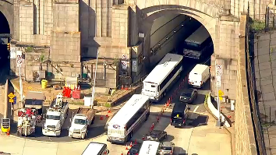
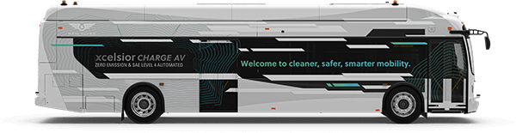
New Flyer - Transit Bus & Coach
Increased Throughput & Efficiency
Traditional Mass Transit
in City
First AV Bus in North America
Precision Docking
Yard Applications
BRT

Slide 19
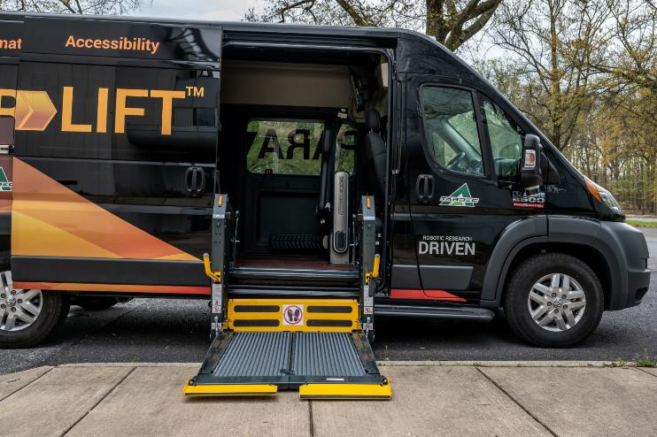
Accessibility in Automated World
Operate without human interaction
Maintain safety of system and surroundings
Accommodate a variety of wheelchair configurations
Perform operations faster than current loading systems
Detect curb/platform

Slide 20
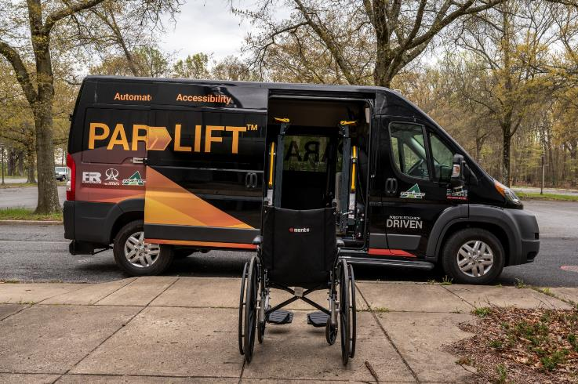
ParaLift Overview
Automatic loading and securement system
Wheelchair passengers enter and exit vehicle with no aid from another person
Intuitive design provides wheelchair passengers with further independence and autonomy in their lives
Features:
Sensing to ensure clear space
Automatic door opener
Powered wheelchair lift
Securement system
Safety system
Announcement system

Slide 21
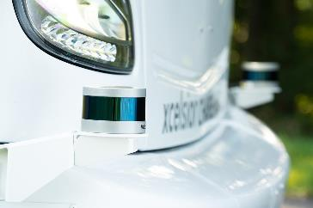
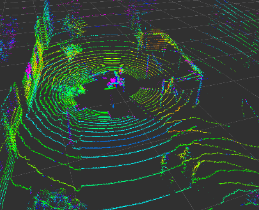
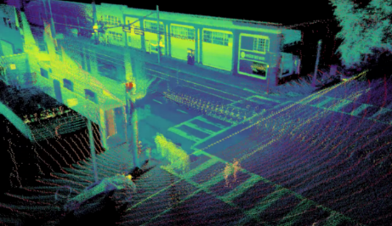
Sensing and Detection
LIDAR sensor generates 3D map of surroundings
Detects the presence of passenger and position of ramp or lift
Ensures area under ramp or lift if clear before lowering
Stops ramp or lift if obstruction
Detect curb and vehicle position
Currently developing camera-based detection system

Slide 22
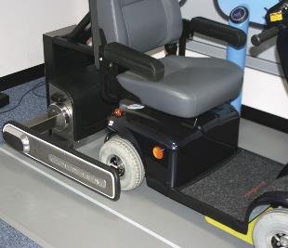
Platform Agnostic
Quantum wheelchair securement system uses a pair of arms to clamp onto wheels of the wheelchair to secure it in place
Three-point seat belt system integration designed to rapidly secure the passenger
Compatible with wheelchairs of various types and sizes
NHTSA crash tested

Slide 23
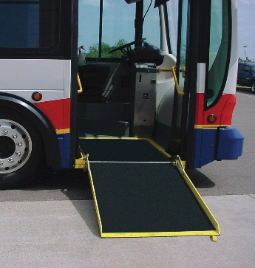
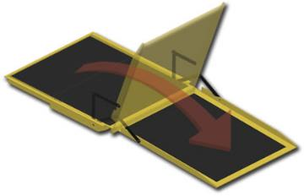
Adaptability
ParaLift can be installed on a variety of commercial vans
Can use existing ramp systems
ParaLift automated system is adaptable to transit buses
Automate control of existing bus ramp and door

Slide 24

Questions

Slide 25
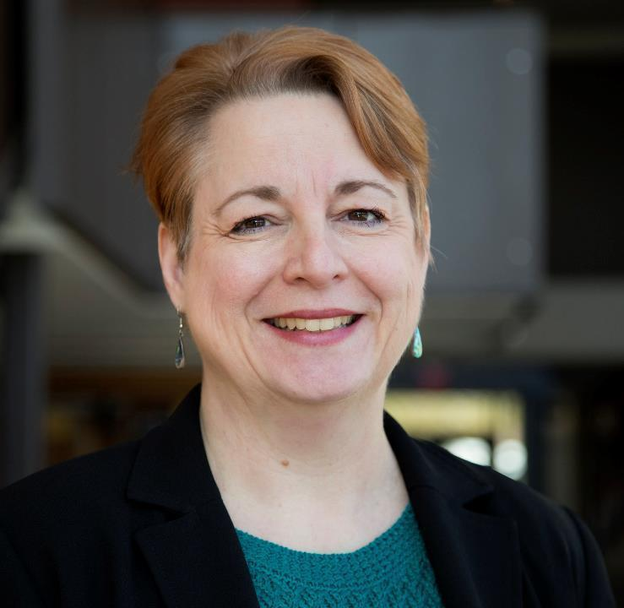
Dr. Kathleen D. Klinich
University of Michigan

Slide 26
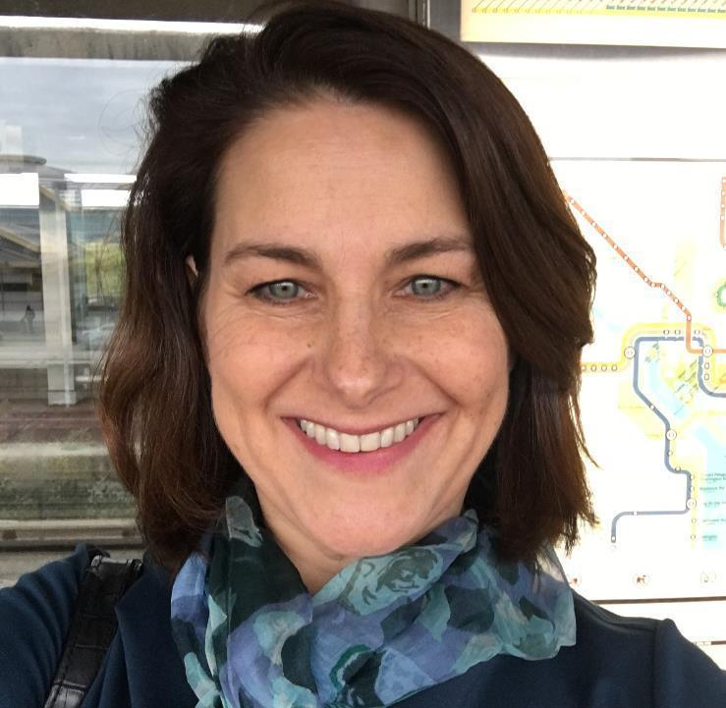
Miriam A. Manary
University of Michigan

Slide 27

Development of an Automated Wheelchair Tiedown and Occupant Restraint System: Initial Progress
Kathleen Klinich, Jingwen Hu,
Miriam Manary, Kyle Boyle, Nichole Orton,
Yushi Wang, Laura Malik, Brian Eby
March 24, 2021

Slide 28
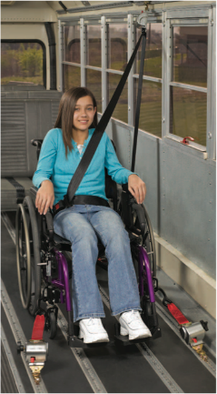
Wheelchair Transportation Safety (WTS)*
Best practice recommendation is to transfer from a wheelchair to a vehicle seat
Wheelchairs used as motor vehicle seats should be crash tested to verify performance (per WC19).
Method to secure the wheelchair to the vehicle. (wheelchair tiedown)
Method to restrain the occupant.
Wheelchair Tiedowns and Occupant Restraint Systems (WTORS)
Ultimate goal of equal level of safety for those who remain seated in wheelchairs.
*Buning, Mary Ellen et al. 2012. “RESNA’s Position on Wheelchairs Used as Seats in Motor Vehicles.” Assistive Technology 24(2).

Slide 29
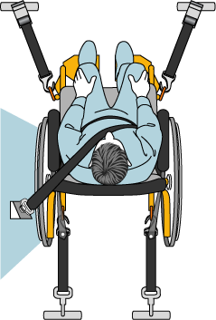
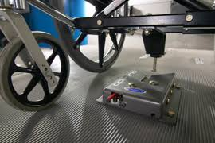
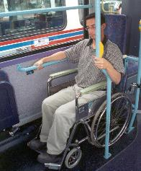
Current WTORS Systems
WTORS Type | Independent Use | Protection in High g and Low g crashes | Any combination of wheelchair and vehicle?
4-pt strap tiedown paired with seatbelt | No | Yes | Yes
Docking station paired with seatbelt | Yes | Yes | No
Rear-facing stations | Yes | No | Yes

Slide 30
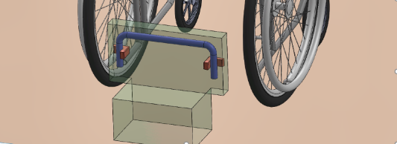
Universal Docking Interface Geometry
Common geometry for connection interface between wheelchairs and vehicles. Akin to standardization of truck trailer hitch.
As long as geometry is met, actual hardware can take any design.
Allows a wheelchair (manual, power, scooter) to dock in any vehicle.
Geometry defined and field tested.
Requires both WC and WTORS manufacturers to work together.
Already implemented in standards, but no commercial use yet.

Slide 31
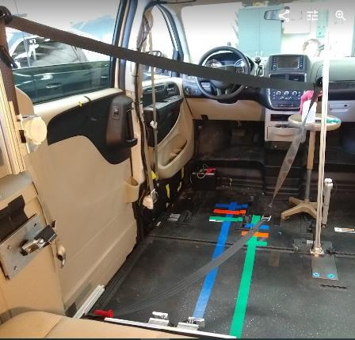
Project Goals and Tasks
Develop an automated wheelchair docking station that would allow safe, independent docking of occupants seated in wheelchairs.
Develop an automated belt-donning system.
Evaluate in front and side impacts.
Computational Modeling
Volunteer Usability Assessment
Sled Testing

Slide 32
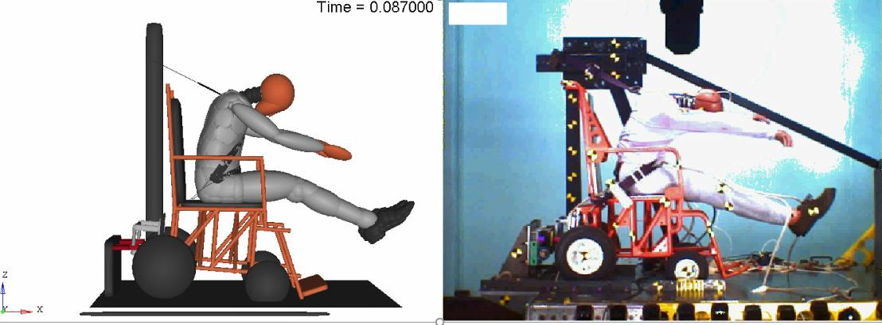
Frontal model validation: surrogate wheelchair fixture

Slide 33
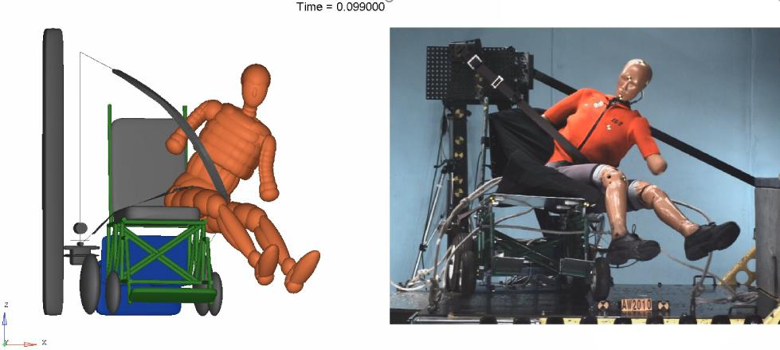
Side model validation

Slide 34
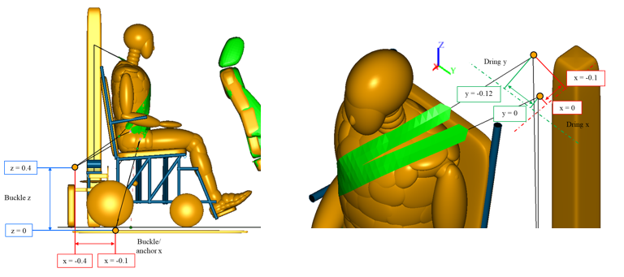
Frontal optimization parameter ranges

Slide 35
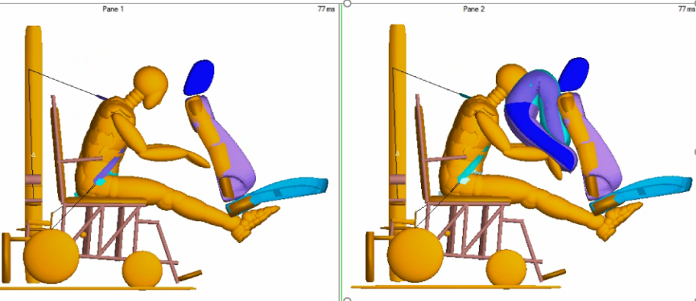
SCARAB airbag
Airbag provides benefit for suboptimal geometry
Providing sufficient space to maneuver wheelchair may reduce potential for head contact

Slide 36
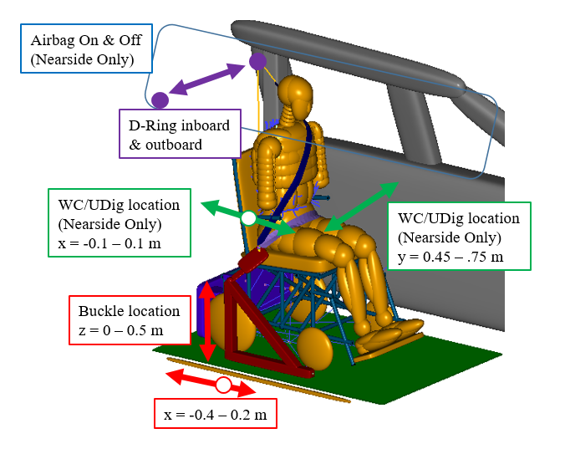
Side impact optimization

Slide 37
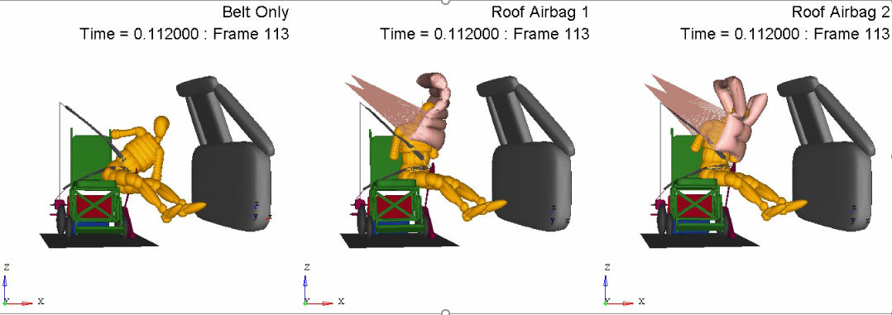
Concept: Center Airbag To Contain Humans (CATCH)

Slide 38
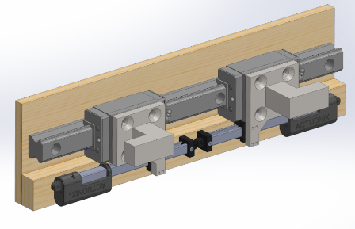
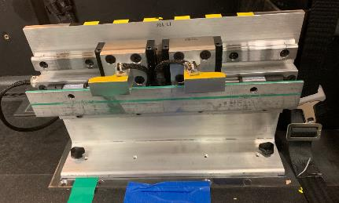
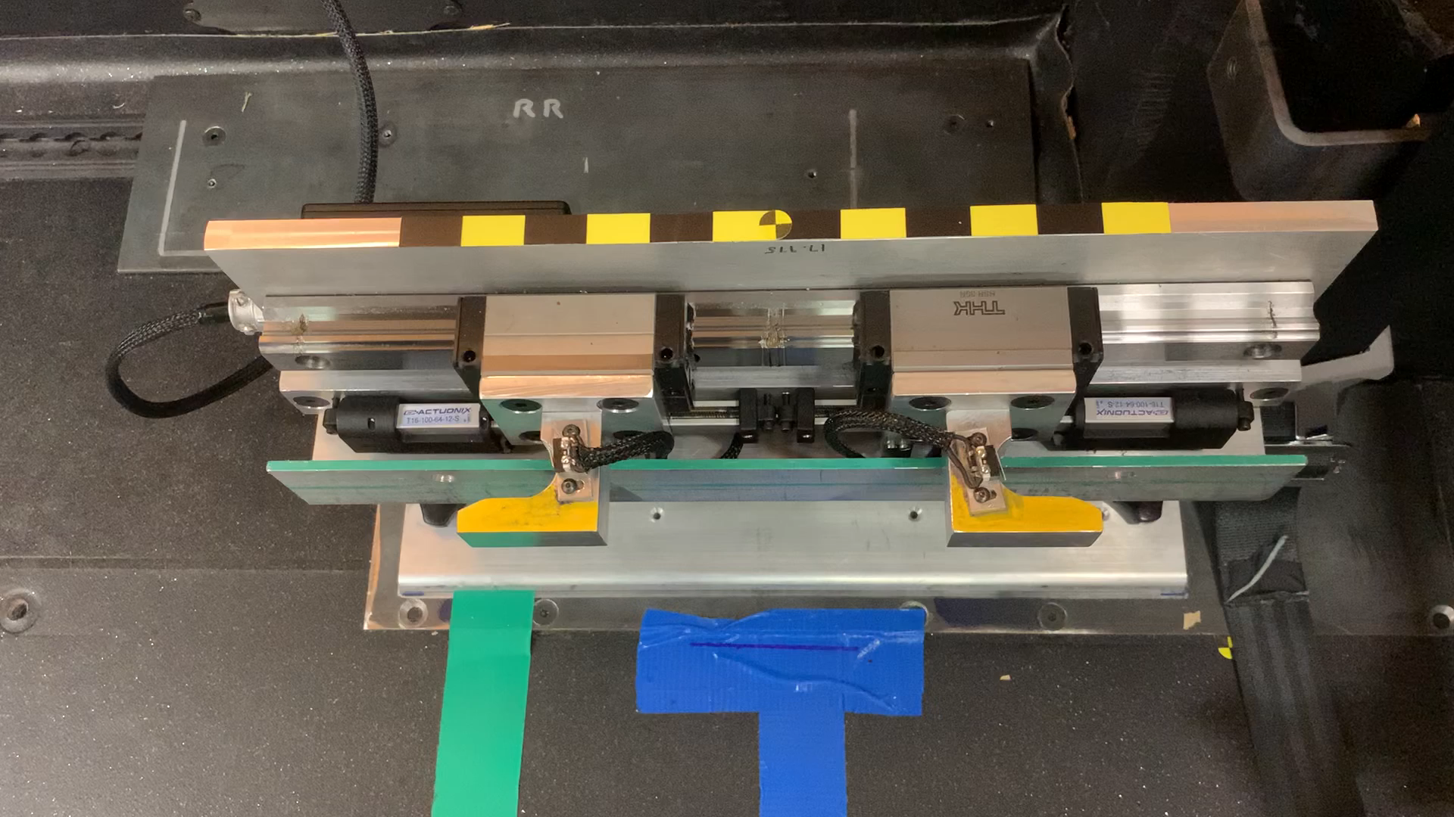
UDIG Anchorages

Slide 39
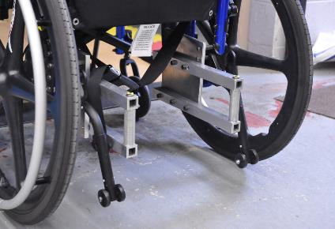
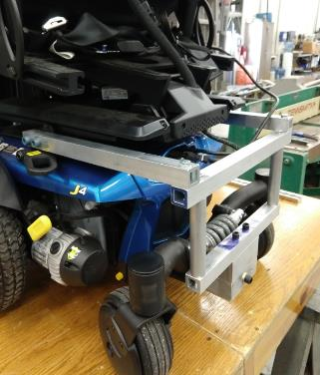
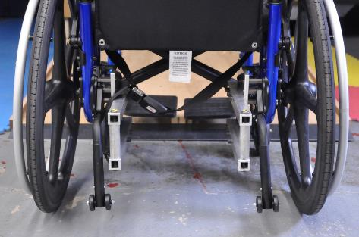
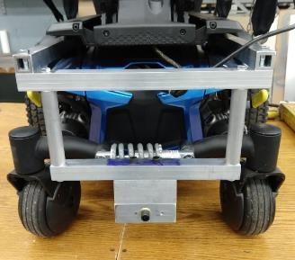
Wheelchair UDIG attachments

Slide 40
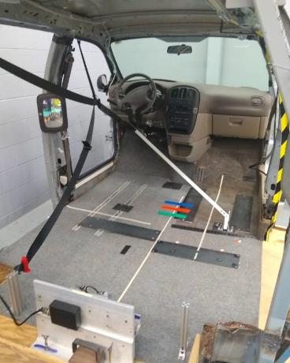
Key goals of volunteer testing
How do different seating station configurations affect accessibility?
How do different belt geometries affect fit, comfort, and usability?
How much variation in belt fit do we get between power and manual wheelchairs in the same condition?
Feedback from regular wheelchair users on usability.

Slide 41
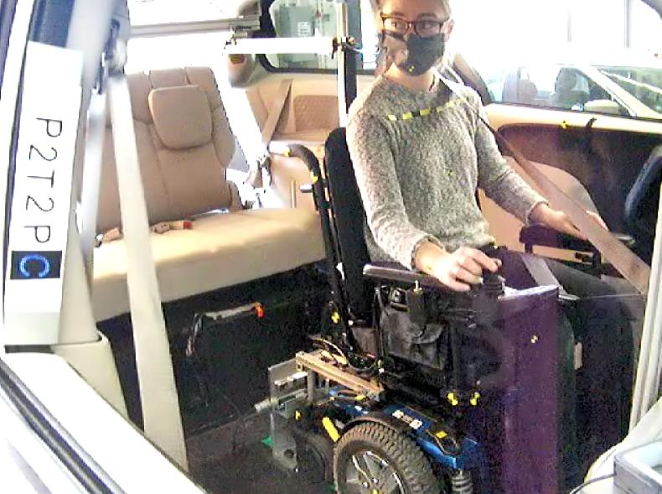
Pilot testing

Slide 42
More information coming
Project finishing up in June
Save the date-Thursday August 5, 2021 1-4 pm
Virtual Open House to share findings from this research
umtri.umich.edu for more information this summer

Slide 43
We would like to thank the National Highway Traffic Safety Administration for sponsoring this project.
Thank you for your attention.
Kathleen D. Klinich kklinich@Umich.edu
Miriam A. Manary mmanary@umich.edu

Slide 44
Questions?

Slide 45

Dr. Jordana Maisel
University at Buffalo

Slide 46
Accessibility for Passengers with Mobility Disabilities: Part 2 Maneuvering and securement
Jordana L. Maisel, PhD
U.S. Access Board Public Forum on Autonomous Vehicles

Slide 47
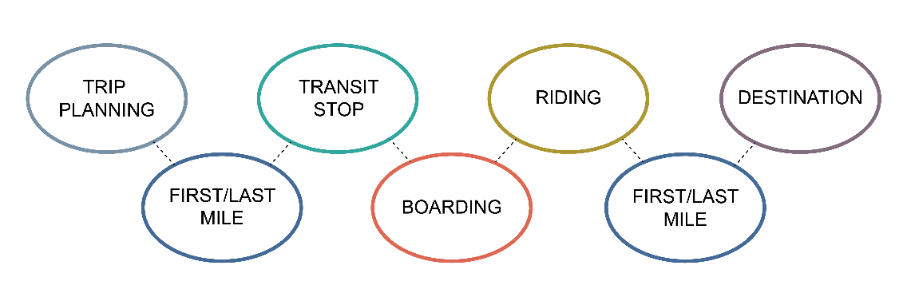
Travel Chain

Slide 48
Research Questions
How does seating configuration impact interior movement and usability for individuals who use wheeled mobility devices, are blind and/or visually impaired, and who use walking aids?
How do different securement systems affect securement time and usability for people who use different types of wheeled mobility devices?
How does field testing newer (i.e., 3-point, forward-facing and semi-automated, rear-facing) securement systems impact usability for manual wheelchair users, power wheelchair users, and scooter users?

Slide 49
Interior Seating Layout

Slide 50
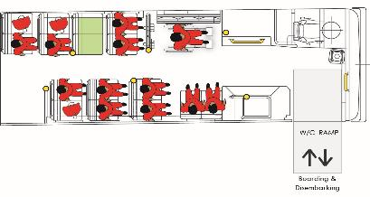
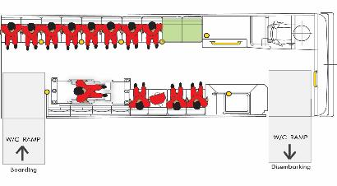

Research Design — Layouts
Layout 1:
Front Entry/Exit
Forward Seating
Layout 2:
Mid Entry, Front Exit
Side Seating
Layout 3
Mid Entry, Mid Exit
Mixed Seating

Slide 51
Research Design — Task Description
Ramp Ascent
Fare Payment
Moving to the Seat/Wheelchair Securement Space (WSC)
Entering and Positioning
Exiting the Seat/WSC
Moving to the Exit Door
Ramp Descent

Slide 52
Study Sample (n=90)
Participant Group | n
Wheeled Mobility Device Users | 48
Blind, Visual Impairment | 18
Walking Aid Users | 24

Slide 53

Findings — WhMD Users (n=48)
Narrow turning space near the front of the bus.
Inadequate turning space with second wheelchair on board.
Side-facing seats less desirable; increased risk of injuring others.
Limited reach capability among wheeled mobility users.

Slide 54

Findings — BVI (n=18) and WA Users (n=24)
Side-facing seats preferred.
Challenges locating features in the environment, e.g., fare payment, vacant seat.
Risk of collisions, trip hazards.
Use of assistive supports during sitting and rising.

Slide 55

Summary
Environment design impacted performance.
Space requirements for walking aid users.
Increasing minimum clearances by small amount will increase the percentage of people accommodated, particularly wheeled mobility users.
There will not be “one best solution” to accessibility.
Everything is interrelated, e.g. fare location and maneuvering, entry location, and stop design.

Slide 56
Securement (Lab)

Slide 57



Research Design — Securement (n=36)
Participant Group | n
Manual Wheelchair | 15
Power Wheelchair | 15
Scooter | 6
4-Point
3-Point Forward-Facing
(3P-FF)
Semi-Automated Rear-Facing
(SA-RF)

Slide 58

Findings — Time, All Participants
Securement Only
Total Time

Slide 59
Preferences
Groups | N | Participant Preference
 |  | 4-Point | 3P-FF | SA-RF
MWC | 15 | 3 | 3 | 9
PWC | 15* | 2 | 2 | 10
Scooter | 6 | 0 | 0 | 6
*Note: One PWC did not specify a preference for a single securement system.

Slide 60
Securement (FIELD)

Slide 61


Research Design (n=40)
Participant Group | n | Age Range
Manual Wheelchair | 14 | 28-71
Power Wheelchair | 19 | 32-74
Scooter | 7 | 38-65
3P-FF
SA-RF

Slide 62

Findings — Difficulty/Acceptability

Slide 63

Findings — RAPUUD, Securement Device

Slide 64

Findings — Rear-Facing

Slide 65
Summary of Findings
A slight majority preferred the SA-RF system to the 3P-FF system.
Although MWC and PWC users rated the use of the SA-RF favorably on many measures, participants in this field study were less likely to prefer the SA-RF.
SC users consistently rated both securement systems as more difficult to use and requiring greater physical effort than MWC and PWC users.
PWC and SC users were almost evenly divided between using fixed-route more or less often due to the presence of the SA-RF.
Design research is needed to explore the capacity for scooters to be secured (rear-facing) safely in public transportation vehicles.

Slide 66
Research Implications for Self-Driving Vehicles
Maneuvering and securing in public transportation are challenging for individuals with mobility and sensory impairments.
Need for greater clearances for maneuvering and securement as evidenced by changing wheelchair dimensions.
Reconfigurable spaces/seating will need to accommodate a wide range of rider needs and preferences.
Fare payment tasks add to the challenges and should be eliminated during trips.
Audio and tactile communication may assist those who are blind or have visual impairments more effectively way find within the vehicles.
Sensing of passenger status (located properly, secured, etc.) will be important.
Independent wheelchair securement requires significant space and designs that accommodate diverse mobility devices.

Slide 67
Sponsor
This presentation was funded in part by grants from the National Institute on Disability, Independent Living, and Rehabilitation Research (NIDILRR) grant numbers H133E080019, 90IFRE0010, and 90RE5011. NIDILRR is a Center within the Administration for Community Living (ACL), Department of Health and Human Services (HHS). The contents of this presentation do not necessarily represent the policy of NIDILRR, ACL, HHS, and you should not assume endorsement by the Federal Government.

Slide 68
Questions/Comments
Jordana L. Maisel, PhD
Center for Inclusive Design and Environmental Access
University at Buffalo School of Architecture and Planning
309 Hayes Hall | 3435 Main St. | Buffalo, NY 14214-8030
jlmaisel@buffalo.edu
idea.ap.buffalo.edu

Slide 69

Open Discussion
Request to share information, ideas, or comments using Zoom’s Q & A feature:
Microphone – you will be allowed to speak
Question – you will not speak, (moderator will read question)
Name (and organization)
Brief description of content
Host will enter you into queue
Moderator will announce when you should unmute (*6 by phone)
Moderator will also announce next in que
Presenters may respond to some comments
Alternative: events@access-board.gov
ASL – note in request to comment
Please limit comments to < 2 min.

Slide 70

Online Dialogue
Continue the conversation Online
http://transportationinnovation.ideascale.com
Share ideas, comment, vote
For assistance, email: ePolicyWorks@dol.gov

Slide 71
Next Session
Accessibility for Passengers with Sensory and Cognitive Disabilities: Part 1
This session will address ride hailing and on-board communication for passengers with hearing, visual, or cognitive disabilities.
April 7, 2021, 2:00 – 3:30 (ET)
Presenters:
Hendrik Opstelten – Federal Transit Administration (FTA)
Anil Lewis – National Federation of the Blind (NFB)
Dr. Robin Brewer, University of Michigan
Dr. Christian Vogler, Gallaudet University

